Slide 1




Huddle Meet
SkillSync
Notes:
Before we move into performance, let me clarify something important. A huddle is not about fault finding. It is about alignment. In sports, a huddle happens before the next move — not after the match is lost. Today is about making sure the next 90 days are stronger than the previous 90. That is the frame. We are not here to debate the past. We are here to structure the future. Are you with me so far?

Slide 2
Agenda
1. 90 Day Performance Overview
2. Mock and Delivery Observations
3. Persistent Gaps and Conduct Alignment
4. Technical Readiness and Pipeline Planning
5. Governance and Ownership Framework
Notes:
This discussion will move in five structured parts — where you stand, what has improved, what still needs tightening, what risk is ahead, and what must change in the next 30 days. No surprises. No emotional swings. Just structured clarity. By the end of this hour, both of us should know exactly what success looks like.

Slide 3
90 Day Performance Overview
Notes:
After 90 days in a new role, what should be visible? Confidence? Stability? Consistency? You have delivered Bootcamp SQL and PL-300. That establishes baseline capability. That matters. Technical foundation is not the issue here. The question now is not “Can you teach?” It is “Can you teach consistently under pressure?” That is a different level.

Slide 4
Deliveries Completed
Bootcamp SQL delivered
DP-900 delivered
PL-300 delivered
Technical capability demonstrated

Slide 5
Progress Status After 90 Days
Strong knowledge depth
Improvement visible
Delivery maturity still stabilizing
Professional consistency required

Slide 6
Mock and Delivery Observations

Slide 7
Mock Feedback Summary
Structured explanation improving
Flow sometimes rushed
Topic closures inconsistent
Executive tone fluctuates under pressure

Slide 8
Client Handling Signals
Occasional overconfidence in discussion
Unnecessary questioning at times
Need for executive framing discipline
Maintain calm response in complex scenarios

Slide 9
Persistent Gaps and Conduct Alignment

Slide 10
Delivery Gaps
Overuse of fillers
Repetitive sentence openings
Rushed transitions
Limited knowledge check integration

Slide 11
Professional Conduct Expectations
Preparation visibility consistency
Mature questioning discipline
Confidence aligned with depth
Executive communication standard

Slide 12
Technical Readiness and Pipeline Planning

Slide 13
Immediate Priority - AI 102
Architecture depth validation required
Lab confidence confirmation
Service integration clarity
Mock before live delivery

Slide 14
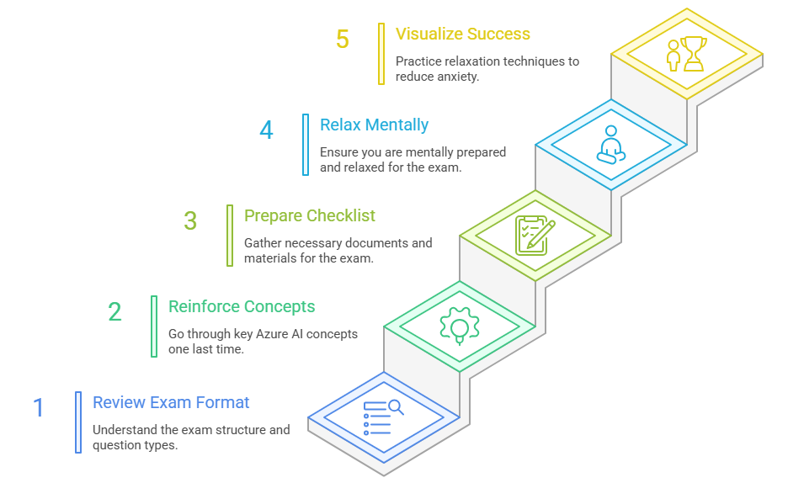
Immediate Priority - AI 102

Slide 15
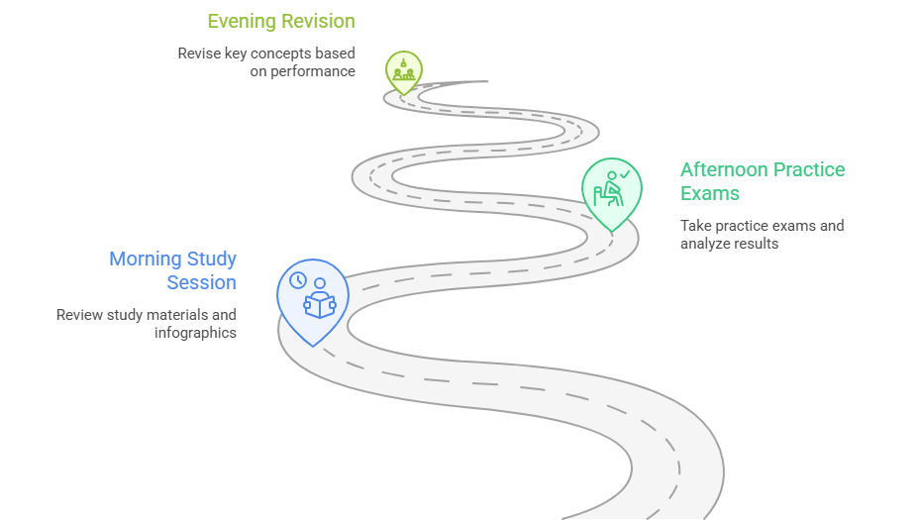
Immediate Priority - AI 102

Slide 16
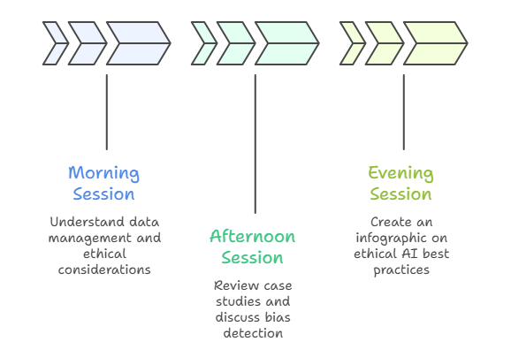
Immediate Priority - AI 102

Slide 17
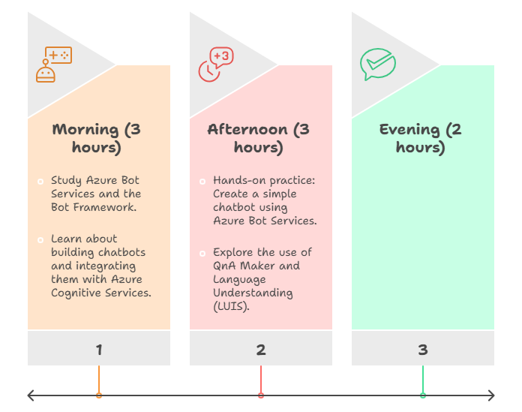
Immediate Priority - AI 102

Slide 18
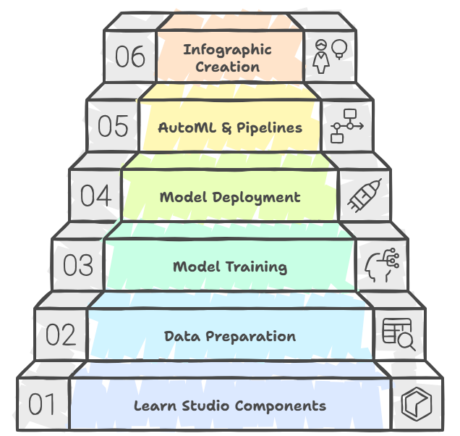
Immediate Priority - AI 102

Slide 19
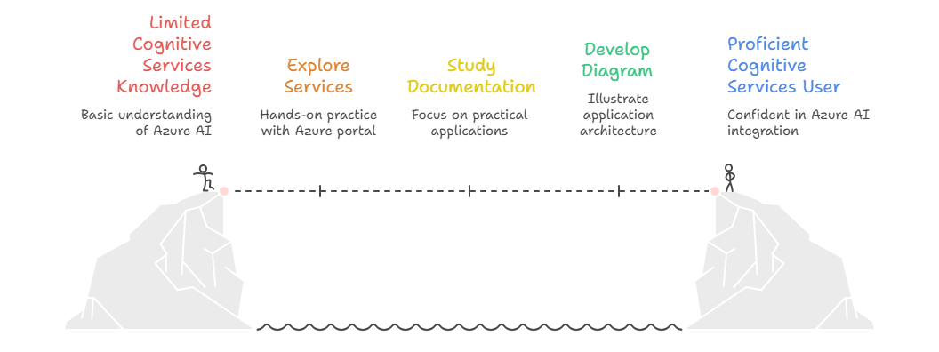
Immediate Priority - AI 102

Slide 20
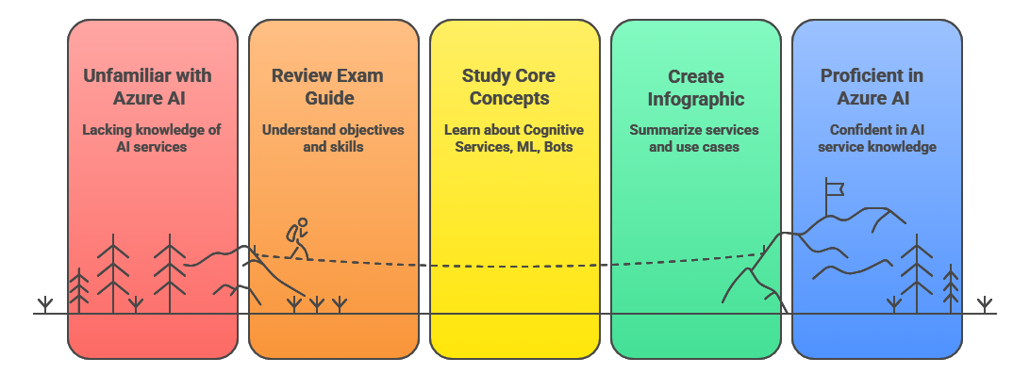
Immediate Priority - AI 102

Slide 21
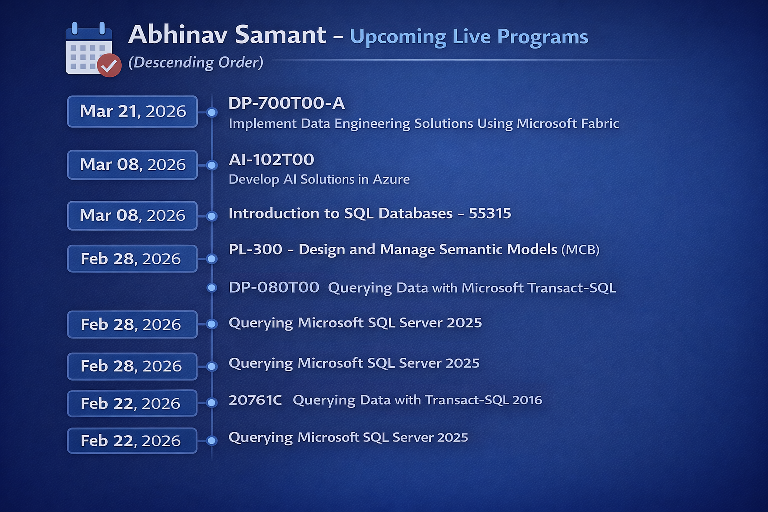

Slide 22
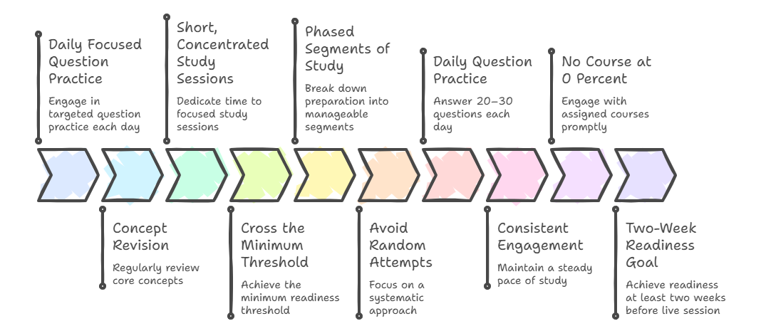
Qubits Governance Strategy
Notes:
Minimum 90 percent before delivery
Two week readiness buffer
Daily preparation tracking
No course at zero percent readiness

Slide 23
Governance and Ownership Framework

Slide 24
Next 30 Day Action Plan
AI 102 full readiness confirmation
Mock before each live session
Delivery maturity refinement
Executive communication stabilization

Slide 25

Executive Summary
Technical capability acknowledged
Maturity gaps clearly identified
Pipeline pressure requires discipline
Structured improvement locked for next 30 days

